Slide 1
GitOps – Git For Ops People
Brett Miller

Slide 2

Who am I?
Live Services Specialist @ Sage
Doing “The DevOps”
5(ish) years PowerShell Experience
Accidental DBA
Infrequently stream Twitch - @PowerShellLive
aka.ms/psslack | aka.ms/psdiscord

Slide 3
Agenda
What is git?
What is GitOps
Why git?
The basic git commands.
Create your first git repository.
git branching.

Slide 4
What is GitOps?
GitOps is the technique of using Git pull requests to manage infrastructure provisioning and software deployment.
Using Git as a single source of truth for declarative infrastructure and applications
Leveraging git to create visibility of work, make tasks repeatable & automated. Encourage collaboration between teams
Notes:
DSC
Ansible
One of the easiest things to get started with automating as you already know how to do it manually.

Slide 5
What is git?
Git is a distributed version-control system for tracking changes in source code during software development.
It is designed for coordinating work among programmers, but it can be used to track changes in any set of files.
Its goals include speed, data integrity, and support for distributed, non-linear workflows.
Notes:
• Created by Linus Torvalds
• Version-Control System
• Used for Source-Control Management
• Distributed
• Effectively it’s a "File System"

Slide 6
What is git in sensible English?
Think of Git as a way to create little waymarkers, or save points, at points in your code’s history.
When you finish a specific feature, or finish a chapter, you can save the current version of your code.
As you check-in your changes, you’ll create a log of your history.
- Tracy Osborn, Really Friendly Git Intro

Slide 7


git vs GitHub
git is a distributed version control tool that can manage a development project's source code history.
git is an open-source tool developers install locally to manage source code.
GitHub is a cloud based platform built around the Git tool.
GitHub is an online service which developers who use git can connect and upload or download source code.

Slide 8
Why git?
Access control
Version control
Distribution and Visibility
It will accelerate your career
Familiarity with the SDLC
It will save you on occasion
Notes:
Protected Master Branch
You have versions/state at any given time
External Visibility
Collaboration

Slide 9
The Basic git Commands
git add
git commit
git pull
git status
git branch
git checkout

Slide 10
Create your first git Repository
New-Item -ItemType Directory -Name PSDayUK
.git
cd PSDayUk
git init

Slide 11
Add Your Scripts
.git
New-Item –ItemType File –Name Function1.ps1
Function1.ps1
Function2.ps1
New-Item –ItemType File –Name Function2.ps1

Slide 12
Show Status
git status
.git
On branch master
No commits yet
Untracked files:
(use "git add <file>..." to include in what will be committed)
Function1.ps1
Function2.ps1
nothing added to commit but untracked files present (use "git add" to track)
Function1.ps1
Function2.ps1
Notes:
Which branch you are on (We’ll come back to this)
If there are any commits already in your local repository
Files which git isn’t keeping track of
YOU WILL USE STATUS A LOT!

Slide 13
Stage Changes in the Index
.git
git add .
Function1.ps1
Function2.ps1
git status
On branch master
No commits yet
Changes to be committed:
(use "git rm --cached <file>..." to unstage)
new file: Function1.ps1
new file: Function2.ps1

Slide 14
Committing Changes to Local Repository
.git
git status
git commit -m "Adding Initial Files"
Function1.ps1
Function2.ps1
[master (root-commit) f8b9ef8] Adding Initial Files
2 files changed, 0 insertions(+), 0 deletions(-)
create mode 100644 Function1.ps1
create mode 100644 Function2.ps1
On branch master
nothing to commit, working tree clean
Notes:
Point-in-time snapshot of the files
Identified by a sha1 hash
Hash made from commit metadata (Message, author, committer, parent) and the files

Slide 15
What is each command doing?
commit -a
add
commit
push
Workspace
index
local repository
remote repo
Notes:
Let’s see what’s happening with your repository when you run these commands
Workspace - The visible files tracked and untracked
Index - Staging for changes .git/index
Local Repository (Object Store) - The local git database .git/objects
Make changes in the workspace
Stage (git add) changes in the Index
Commit (git commit) changes to the Local Repository

Slide 16
Using git log to See Our Commits
.git
git log
Function1.ps1
Function2.ps1
commit f8b9ef8d236f7dd2ebf8bd43d674df9ba90a5bf4 (HEAD -> master)
Author: Brett Miller <brett@millerb.co.uk>
Date: Tue Sep 24 17:54:18 2019 +0100
Adding Initial Files

Slide 17
Branching
Branching allows you to have two different versions of your code simultaneously.
This means you can add features or fix broken code without impacting anyone or anything using your code.
Master

Slide 18
Branching
Keep branches short lived. You will end up never merging into master.
Isolate your code – Don’t get carried away doing more than one thing.
Feature
Master
Notes:
Don’t get carried away

Slide 19
Branching
Commit often and use meaningful commit messages.
“Added Stuff” & “Work damn it” are not useful to future you.
Learn the basics of git and agree on a way of branching that works for you and your organisation.
Feature
Feature
Master
Feature
Notes:
Don’t get carried away

Slide 20
Create a new branch
.git
git branch newFunctions
Function1.ps1
Function2.ps1
git branch
* master
newFunctions
Notes:
Git checkout –b <BranchName>

Slide 21
Create a new branch
.git
git checkout newFunctions
Function1.ps1
Function2.ps1
git branch
* master
newFunctions

Slide 22
Add Additional Scripts
.git
New-Item –ItemType File –Name Function3.ps1
Function1.ps1
Function2.ps1
New-Item –ItemType File –Name Function4.ps1
Function3.ps1
Function4.ps1

Slide 23
Stage Changes in the Index
.git
git add .
Function1.ps1
Function2.ps1
git status
On branch newFunctions
No commits yet
Changes to be committed:
(use "git rm --cached <file>..." to unstage)
new file: Function3.ps1
new file: Function4.ps1

Slide 24
Committing Changes to Local Repository
.git
git status
git commit -m "Added Function 3 & 4"
Function1.ps1
Function2.ps1
Function3.ps1
Function4.ps1
On branch newFunctions
nothing to commit, working tree clean
[master (root-commit) f8b9ef8] Adding Initial Files
2 files changed, 0 insertions(+), 0 deletions(-)
create mode 100644 Function3.ps1
create mode 100644 Function4.ps1
Notes:
Point-in-time snapshot of the files
Identified by a sha1 hash
Hash made from commit metadata (Message, author, committer, parent) and the files

Slide 25
The Basic Workflow
git add
git commit
git branch
Make changes

Slide 26
Quick Demo

Slide 27
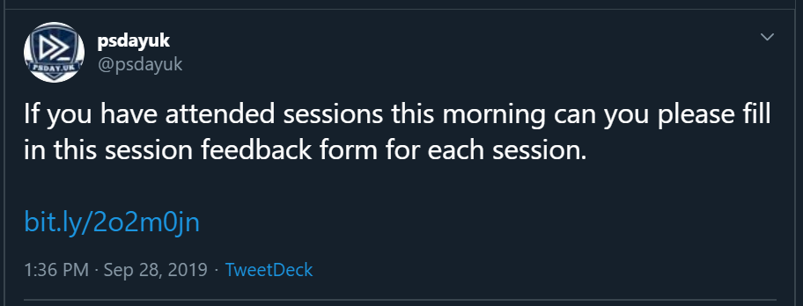
Feedback

